Slide 1

AUTOMATED RAILWAY SIGNALLING SYSTEM
Batch no-A19
PRESENTED BY
S.Isnehashankar(211419104108)
M.Linnet Blessy(211419104147)
A.Girija(211419104078)
B.E.COMPUTER SCIENCE
UNDER THE GUIDANCE OF
S. T.Santhanlakshmi, M.Tech.,
Department of CSE.

Slide 2
INTRODUCTION:
Railways constitute a major portion of transport infrastructure in most countries. It is essential to employ good strategies for the maintenance of railway networks to avoid a disruption to services and ensure the safety of the system. For example, the railway track condition needs to be regularly monitored to detect faults at an early stage before they become major issues.
The Indian Railways is among the world's biggest rail systems. The Indian Railways course length arrange is spread more than 115,550 km, with 12,617 passenger trains and 7,421 goods prepares every day from 7,439 stations handling 26 million travelers and 3.5million tons (MT) of cargo day by day.
India's railroad organize is perceived as one of the biggest railroad frameworks on the planet under single administration. The rail road arranges is likewise perfect for long travel and development of mass products, aside from being a vitality effective and financial method of movement and transport.
In this system, the development of a low-cost sensor node that focuses on the concept of train arrival time detection and updating is Key. We get the train arrival time at the station and update the information on the webpage with the train id.

Slide 3
ABSTRACT:
Human development is directly related to the transport facility. India has been starting its transport through railways since 19th century.
The Indian railway system is very big and very complicated. When generation moves forward, the technology and complexity are also moves to its higher levels. Now days, there is no exact communication between Indian railways and passengers
So we introduce Automated Railway Signaling System (ARSS) which automatically collect the information about the Train. The movements of the train can be controlled based upon the signal which will be automatically generated by the system.
In this system, we get the train's arrival time at the station with the help of an RTC and proximity sensor, update the information in the Java web application with the train's ID with the help of an RFID module.
If another train arrives in the same track, it will automatically intimate the co-driver to allocate the track according to their availability in order to send to their respective platform, and also send updates to the co-driver with the help of a ZIGBEE transmitter. Then the Java web application will send Gmail to the persons who are logged into the web application.
We are planning to provide a system to automatically collect the information about trains and make the schedule based on track availability.

Slide 4
EXISTING SYSTEM:
Railway track monitoring and maintenance is essential for an effective and safe railway operation. Absence of agreed, stable and effective track fault detection methods, results in safety alerts, accidents and losses in terms of assets, time, and lives.
Thus, satisfactory and timely track maintenance and fault prevention should be conducted as a matter of fact. In many developing nations, the present typical railway cart for track inspection involves manual inspection, heavily relying on human action and judgement for track defect identification.
A smart IoT based railway cart is proposed to autonomously identify railway track faults using acoustic analysis and localization. The microphone and GPS sensor mounted on RPi positioned near the wheels of the cart was used to record the sound and send acoustic signal and a GPS location every five seconds to a remote cloud.
A dataset was maintained by deriving forty MFCC features from the collected fault sounds. Different machine learning models were trained and evaluated on this data. Amongst them, MLP achieved 98.4% accuracy.
The authors are now preparing for a IoT system for the train rather than railway carts to gather more fault types or data from other typical railway terrains through international collaboration.

Slide 5
PROPOSED SYSTEM:
Here we choose RFID ,every train have a separate tag, reader is placed on a separate signal lamp post which is placed before a railway station in particular distance.
Inductive proximity sensor which placed nearly same location where reader placed, but our proximity sensor placed in track.
The reason we used this sensor is ,it only identifies the metal object so it avoids the false trigger.
Moreover, the message should be passed to respective Station Signalling Authority Portal or the Signalling Expertise as acknowledgement of the allocation.
we can update the arrived time of the train with train id.
This system updates the time with respected id of the train to the cloud.

Slide 6
LITERATURE SURVEY:
Year | Author Name | Paper Title | Methodology | Merits | Demerits
2022 | Hafeez Ur Rehman Siddiqui, Adil Ali Saleem, Muhammad Amjad Raza, Kainat Zafar, Kashif Munir, Sandra Dudley | Iot Based Railway Track Faults Detection And Localization Using Acoustic Analysis Volume-10 Issued On- 27 Sep 2022 Journal -IEEE | Acoustic Analysis and Localization Machine Learning Algorithms | This system would reduce human error, provide greater inspection ranges and accuracy and reduce overall labor costs. | It detects only few fault types that are mentioned.

Slide 7
Year | Author name | Paper title | Methodology | Merits | Demerits
2022 | Alan Shaju, Aravind Madhu , Doel Sam | Automated railway track crack detection system Volume -7 Issued On- 4 April 2022 Journal-IEEE | Crack Detection Using LED-LDR | The idea can be implemented in large scale to facilitate better safety standards for railway tracks in future. This autonomous vehicle will have a great impact on the safety and maintenance of tracks. This vehicle will help in preventing train accidents. | The system is designed in such a manner that the vehicle should not engage the train routine and should work on empty tracks. In case of train arrival, such mechanisms should be developed so that the vehicle should get fold between the tracks without disturbing the train’s routine

Slide 8
Year | Author Name | Paper Title | Methodology | Merits | Demerits
2020 | Yanqiu Li, Xinyue Xu, Jianmin Li, Rui Shi | A Delay Prediction Model For High-Speed Railway Issued On-24 December 2020 Journal- IEEE Conference | An extreme learning machine (ELM) tuned via particle swarm optimization (PSO) is proposed to predict train arrival delays of HSR lines. | It can be used to guide the dispatchers to arrange the train transportation organization in case of delay problem. | Less accuracy in predicting train arrival delay.

Slide 9
Year | Author Name | Paper title | Methodology | Merits | Demerits
2020 | Hamad Alawad, Sakdirat, Kaewunruen. | A Deep Learning Approach Towards Railway Safety Risk Assessment Volume –8 Issued On –27 May 2020 Journal -IEEE | Proposed an efficient railway system technique framework based on a CNN and applied DL algorithms to foster detection of unwanted events in railway stations | Improves safety and security throughout the entire railway industry paradigm. | The data availability and quality remain a challenge because this technology depend heavily on large amounts of high-quality data.

Slide 10
Year | Author Name | Paper Title | Methodology | Merits | Demerits
2019 | Qi Zhang, Zhiming Yuan, Lu Yan, Tao Zhang, Yifeng Miao, Shuxin Ding | A Railway Train Number Tracking Method Using A Prediction Approach Volume-7 Issued On-25 SEP 2019 Journal -IEEE | Centralized traffic control (CTC)System, , Hidden Markov model | Obtain the accurate real-time train number and location in a railway network. | Fault zone are created by more than two neighbour blocks and some trains are delayed more than the deviation compensations.

Slide 11
Year | Author Name | Paper Title | Methodology | Merits | Demerits
2018 | Y. Baviskar, U. Suryawanshi, A. Sheikh | Modelling of Track Layout for Intelligent Railway Signalling System: A Machine Learning Application Issued On- 10 DEC 2018 Journal-IEEE Conference | For modelling, IR standard single line station layout is considered and graphical model based design techniques are implied. | It will not only provide a comprehensive level of safety in railway transportation but also takes a step forward towards systematizing various methods and strategies such as rescheduling system, monitoring performance under one roof using ML | • The construction of ISS is a complicated task. • Due to the current technology limitation, which cannot match the intelligence and ﬂexibility of human beings, it is not possible to replace manual reporting made by humans with automatic reporting systems

Slide 12
Year | Author name | Paper title | Methodology | Merits | Demerits
2017 | DR.R.Velayutham, T.Sangeetharani, K.Sundaralakshmi. | Controlling Railway gates using smart phones by tracking trains with GPS Issued On-21 APR 2017 Journal -IEEE Conference | It works based on Internet of Things. Track and detect the arrival of the train by using GPS-(Global Positioning System) | Reduces the number of accidents and the manpower in the railway crossing. | This Android application can’t be used by the third party

Slide 13
Year | Author Name | Paper Title | Methodology | Merits | Demerits
2017 | Dr. F. Balouchi, Dr. A. Bevan, R. Formston | Detecting Railway Under-track Voids Using Multitrain In-service Vehicle Accelerometer Issued On- 08 May 2017 Journal- IEEE Conference | Signal Processing, Multi-Source Data Analysis | • Improving train safety, network reliability and passenger comfort. • Algorithms are used to predict with more accuracy the condition of large portions of the network at a high rate and with very low cost. | • A voided sleeper is not able to support the vehicle axle load and does not transfer any force to the ballast layer. • Road crossing do not appear clearly in the data.

Slide 14
Year | Author Name | Paper title | Methodology | Merits | Demerits
2016 | Sarngadi Palgunadi, Dian Supraba , Bambang Harijito | Job-shop Scheduling Model For Optimization Of The Double Track Railway Scheduling Issued On -12 Oct 2016 Journal –IEEE Conference | Genetic Algorithm, Neural Network , Ant Colony Optimization (ACO), Simulation Annealing, Greedy Job-shop , FCFC, priority queue. | Scheduling trains in order to minimize the delay time. Used to solve secondary delays to other trains in the network. | The proposed scheduling model is not promising to solve the problem because the average delays are greater than the actual schedule although the number of delayed train are less. Conflict among trains.

Slide 15
Year | Author Name | Paper Title | Methodology | Merits | Demerits
2014 | J.Guo, X.Wang, Y.Zhang, Y.Yang. | Future prospects on the intelligent monitoring technologies for Railway Signalling system Issued On-18 SEP 2014 Journal-IEEE Conference | Centralized signalling monitoring system (CSM) | Used to overcome the problems involved such as interconnection, data sharing and intelligent analysis, an integrated scheme of the intelligent monitoring and maintenance system for railway signaling systems. | • Need to pay attention to monitoring and maintenance of the management network security, •Strictly implement the safety protecting measures to prevent the invasion of the hackers and virus.

Slide 16
PROBLEM STATEMENT :
In general, Railway system is the most commonly used transportation system especially in India. But due to miscommunication about the railway schedules and lack of coordination, accidents happen. And there is no exact communication between Indian railways and passengers. In this system, we get the train arrived time of the station and update the information to the webpage with the train id.

Slide 17
TECHNOLOGY STACK
HARDWARE REQUIREMENTS | SOFTWARE REQUIREMENTS
ARDUINO UNO ARDUINO MEGA POWER SUPPLY LCD DISPLAY PROXIMITY SENSOR RFID READER RFID TAG (5) BUZZER SERVO MOTOR RS232 RTC ZIGBEE PAIR | EMBEDDED C ARDUINO IDE JAVA ECLIPSE

Slide 18
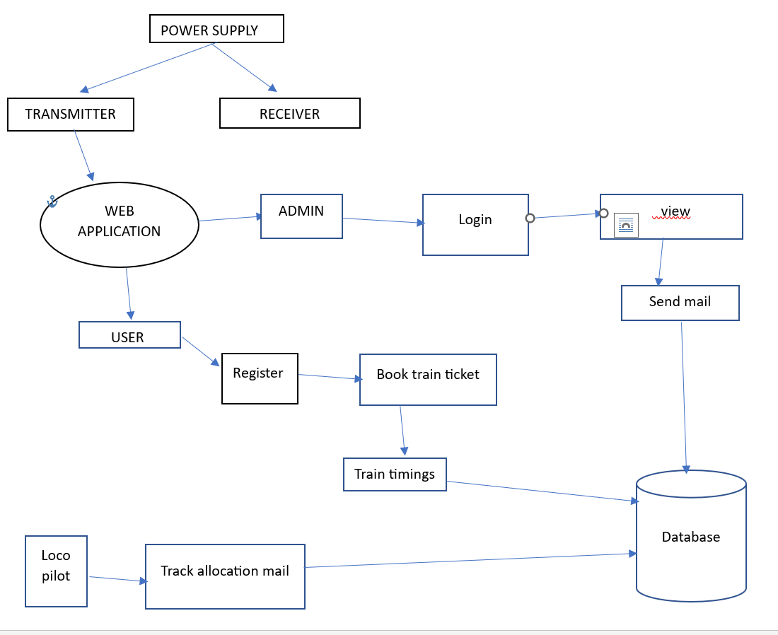
SYSTEM ARCHITECTURE

Slide 19
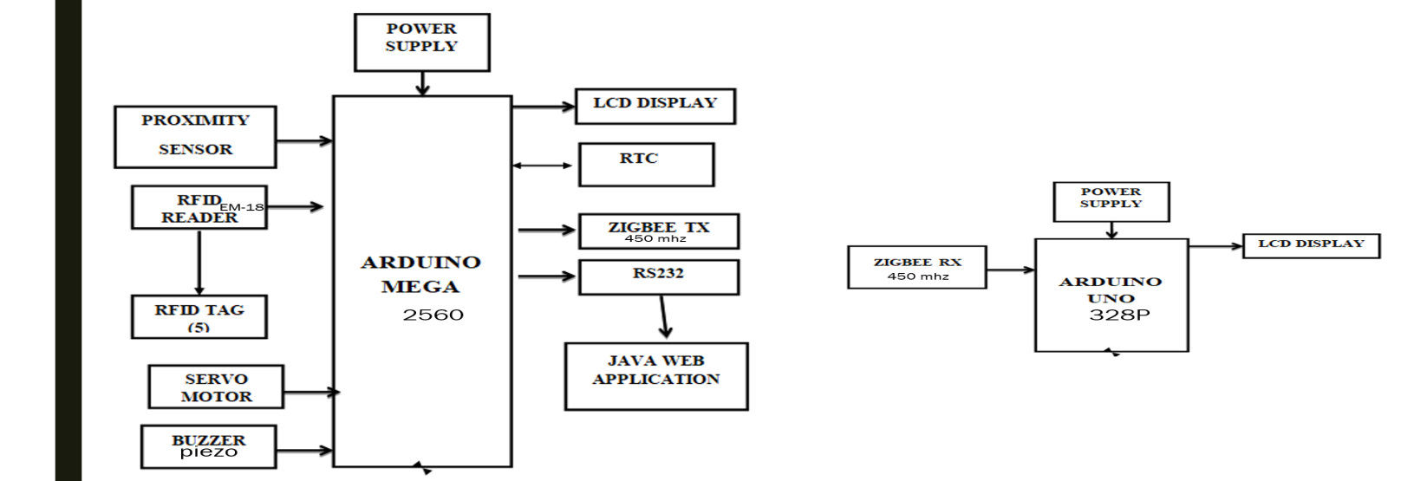

HARDWARE ARCHITECTURE:
TRANSMITTER
RECEIVER

Slide 20
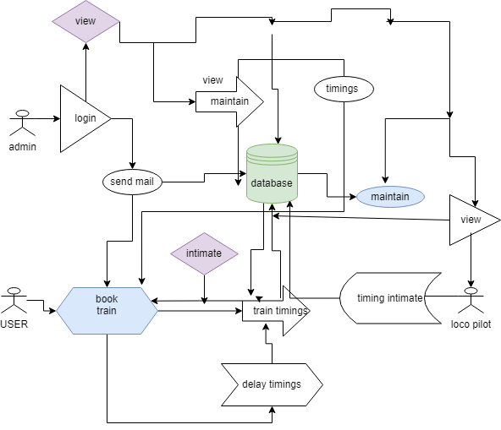
SOFTWARE ARCHITECTURE:

Slide 21
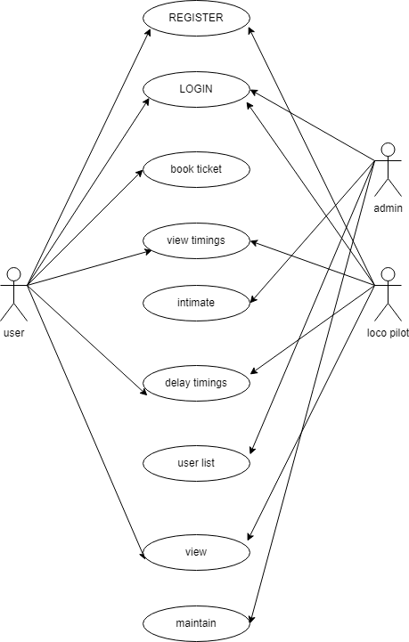
USE CASE DIAGRAM:

Slide 22
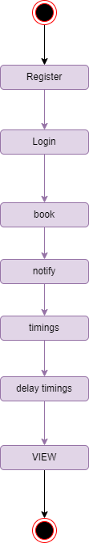
STATE DIAGRAM:

Slide 23
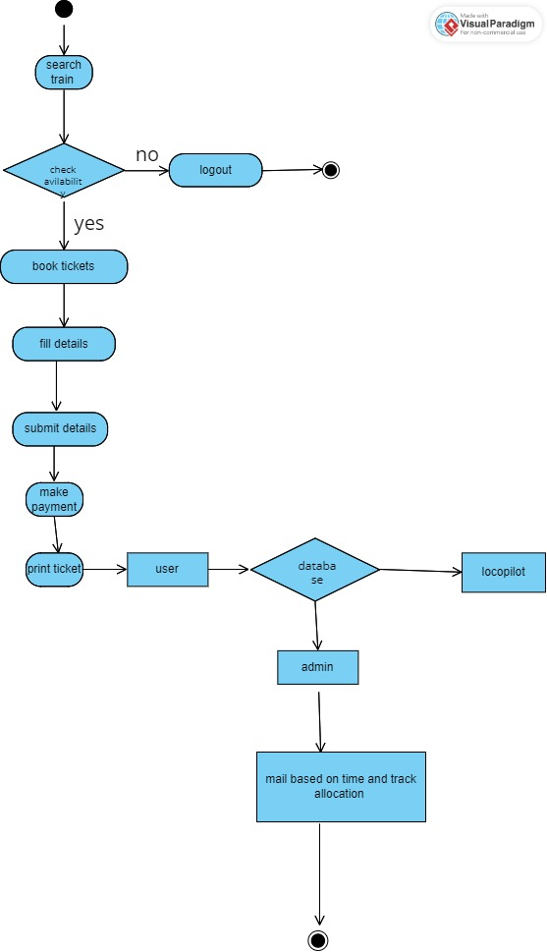
ACTIVITY DIAGRAM:

Slide 24
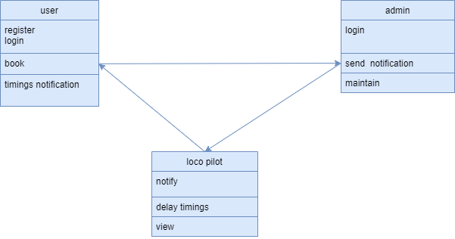
CLASS DIAGRAM:

Slide 25
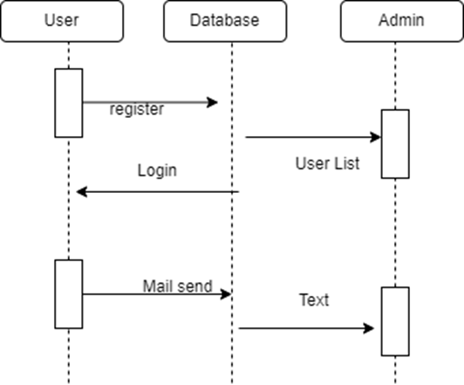
SEQUENCE DIAGRAM:

Slide 26
MODULE DESCRIPTION:
DETECTING THE TRAIN
TIME DETECTING
UPDATING
RECEIVER

Slide 27
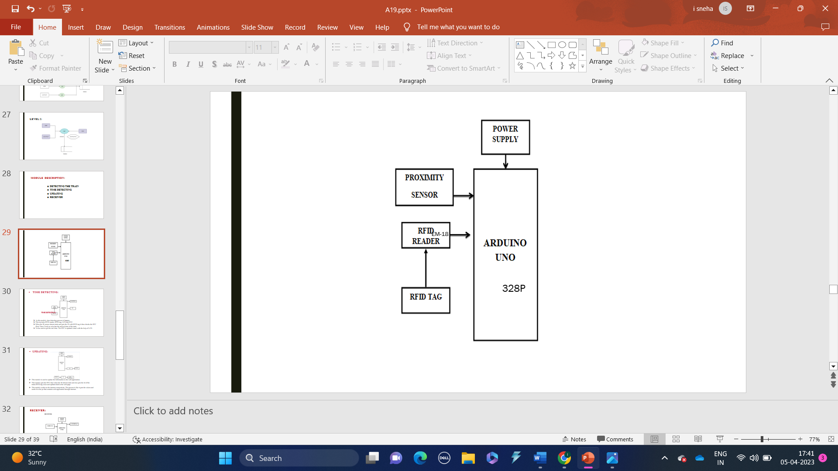
DETECTING THE TRAIN:
In this module detecting of the Train is happen. In this we use IR sensor, RFID reader and RFID tag.
We use IR sensors to detect the train that arrives on the platform. The RFID tag is placed in the train to identify which train is coming.
The RFID reader is placed in the station to read the RFID tag. This module helps to detect which train is coming.

Slide 28
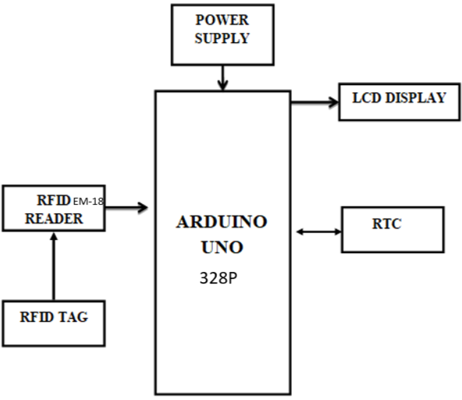
TIME DETECTING:
In this module, time detecting process is happen.
This includes RFID reader, RFID tag, LCD and RTC.
When the IR sensor detects train and gets the ID with RFID tag it then checks the RTC (Real Time Clock) to calculate the arrived time of the train.
It also used to get the real time. The RTC is updated visual with the help of LCD

Slide 29
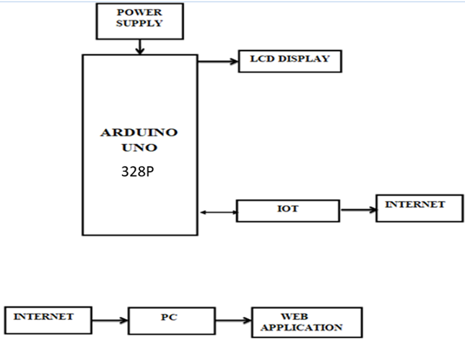
UPDATING:
This module is used to update the information to the web application.
This module gets the RTC time when the IR detects train and also gets the id of the trains RFID tag value and updates both in the web page.
This module works on the internet connectivity. The process is like it gets the values and sends it to the pc that contains web application through internet.

Slide 30
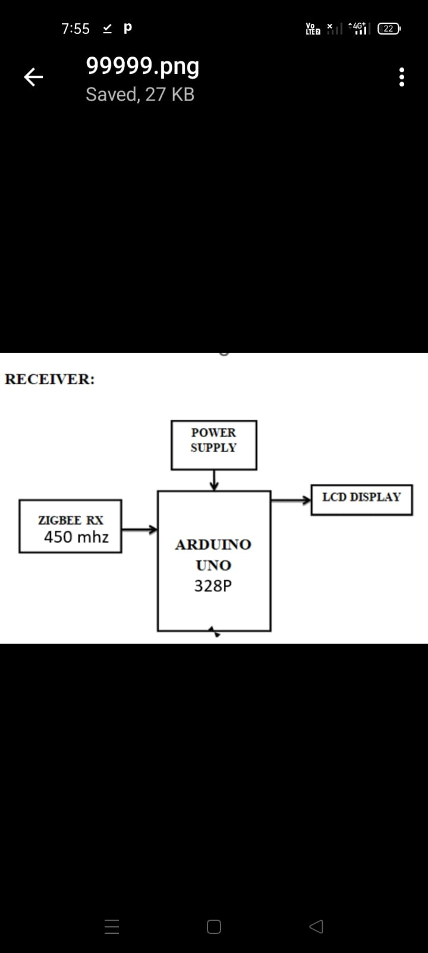
RECEIVER:
In this module, the ZIGBEE receiver side is happen.
This module is present in train for updating the information to the co-driver. This module sends time through the ZIGBEE module and the train time is updated to the LCD for co-driver.

Slide 31
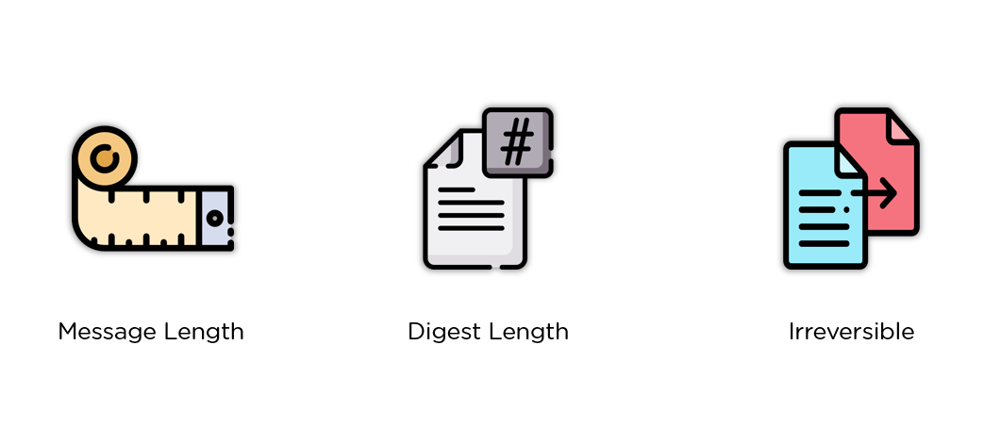
ALGORITHM DESCRIPTION
SHA-256:
SHA 256 is a part of the SHA 2 family of algorithms, where SHA stands for Secure Hash Algorithm. Published in 2001, it was a joint effort between the NSA and NIST to introduce a successor to the SHA 1 family, which was slowly losing strength against brute force attacks.
The significance of the 256 in the name stands for the final hash digest value, i.e. irrespective of the size of plaintext/clear text, the hash value will always be 256 bits.
SHA-256 algorithm works by taking a piece of information and passes it through a function that performs mathematical operations on the plaintext. This function is called the hash function, and the output is called the hash value/digest.
The main reason technology use SHA-256 is that it doesn’t have any known vulnerabilities that make it insecure and it has not been “broken” unlike some other popular hashing algorithms.

Slide 32
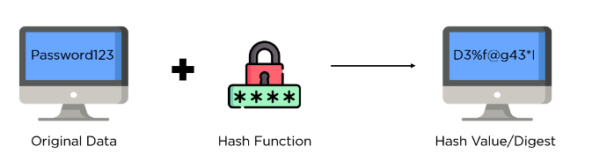
HASHING:
Hashing is the process of scrambling raw information to the extent that it cannot reproduce it back to its original form.
It takes a piece of information and passes it through a function that performs mathematical operations on the plaintext.
This function is called the hash function, and the output is called the hash value/digest.
Cryptographic hash algorithms produce irreversible and unique hashes. The larger the number of possible hashes, the smaller the chance that two values will create the same hash.

Slide 33
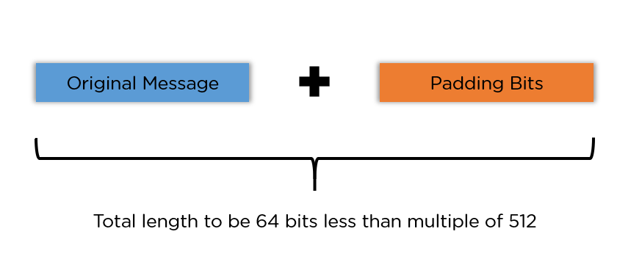
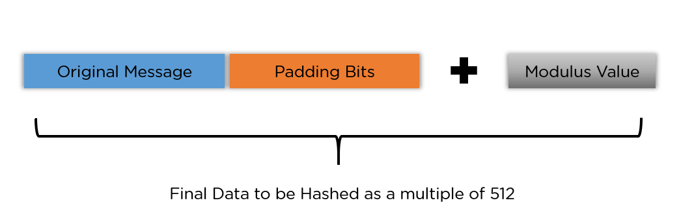
CHARACTERISTICS OF THE SHA-256 ALGORITHM:
Message Length: The length of the clear text should be less than 264 bits. The size needs to be in the comparison area to keep the digest as random as possible.
Digest Length: The length of the hash digest should be 256 bits for the SHA-256 algorithm, 512 bits for SHA-512, and so on. Bigger digests usually suggest significantly more calculations at the cost of speed and space.
Irreversible: By design, all hash functions such as SHA-256 are irreversible. You should neither get the plaintext when you have the digest beforehand nor should the digest provide its original value when you pass it through the hash function again.

Slide 34
PERFORMANCE EVALUATION
MODULE NAME: Detecting The Train
MODULE NAME: Time Detecting
TEST CASE ID | TESTCASE NAME | INPUT | EXPECTED OUTPUT | ACTUAL OUTPUT | RESULT
TC01 | Train Detection | IR sensor, RFID reader, RFID Tag | IR sensors should detect the train that arrives on the platform. (Scr 1) | IR sensor detects the train that arrives on the platform. (Scr 1) | Pass
TEST CASE ID | TEST CASES NAME | INPUT | EXPECTED OUTPUT | ACTUAL OUTPUT | RESULT
TC01 | To detect the train and mail the passengers about the early arrival of train | RFID Tag, RFID reader, RTC, LCD | Train along with time should be detected and passengers should receive mail from admin (Scr 5) | Train along with time is detected and passengers received mail from admin (Scr 5) | Pass

Slide 35
TC02 | To detect the train and mail the passengers about the delay arrival of train | RFID tag, RFID reader, RTC, LCD | Train along with time should be detected and passengers should receive mail from admin (Scr 6) | Train along with time is detected and passengers received mail from admin (Scr 6) | Pass
TC03 | To detect the train and mail the passengers about the On-Time arrival of train | RFID tag, RFID reader, RTC, LCD | Train along with time should be detected and passengers should receive mail from admin (Scr 7) | Train along with train is detected and passengers received mail from admin (Scr 7) | Pass

Slide 36
MODULE NAME: Updating
TEST CASE ID | TEST CASE NAME | INPUT | EXPECTED OUTPUT | ACTUAL OUTPUT | RESULT
TC01 | To Update the information (Train Time, ID) TO THE WEB APP | RTC, RFID Tag, RFID Reader | Information should be updated to web application (Scr 8) | Information Updated to Web App (Scr 8) | Pass
MODULE NAME: Receiver
TEST CASE ID | TESTCASE NAME | INPUT | EXPECTED OUTPUT | ACTUAL OUTPUT | RESULT
TC01 | Updating the Train information (Unexpected train arrives in same track) to the co-driver through mail | ZIGBEE RX,RFID Tag, RFID reader | Loco Pilot should receive mail from admin (Scr 9) | Loco Pilot received mail from admin (Scr 9) | Pass

Slide 37
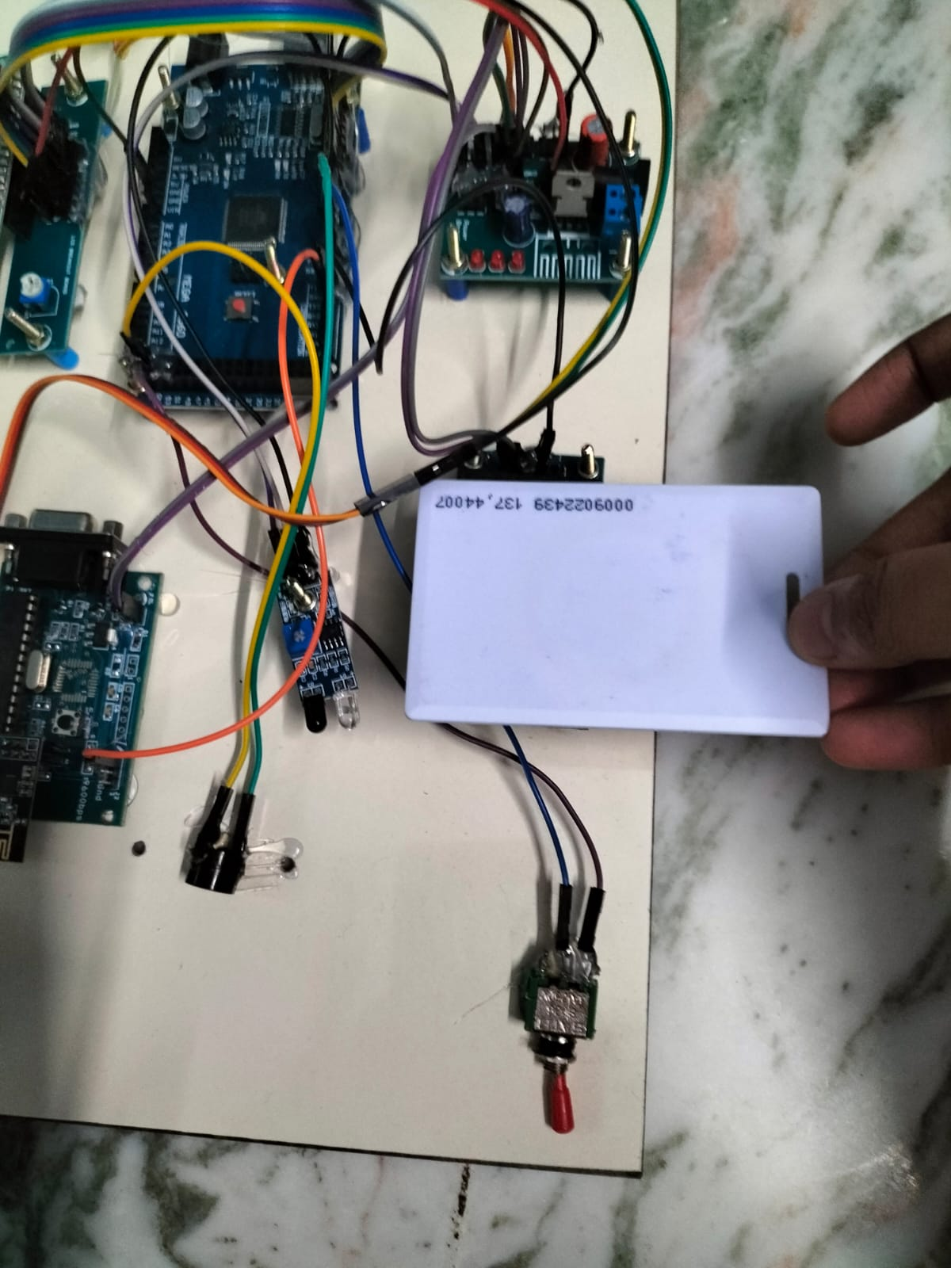
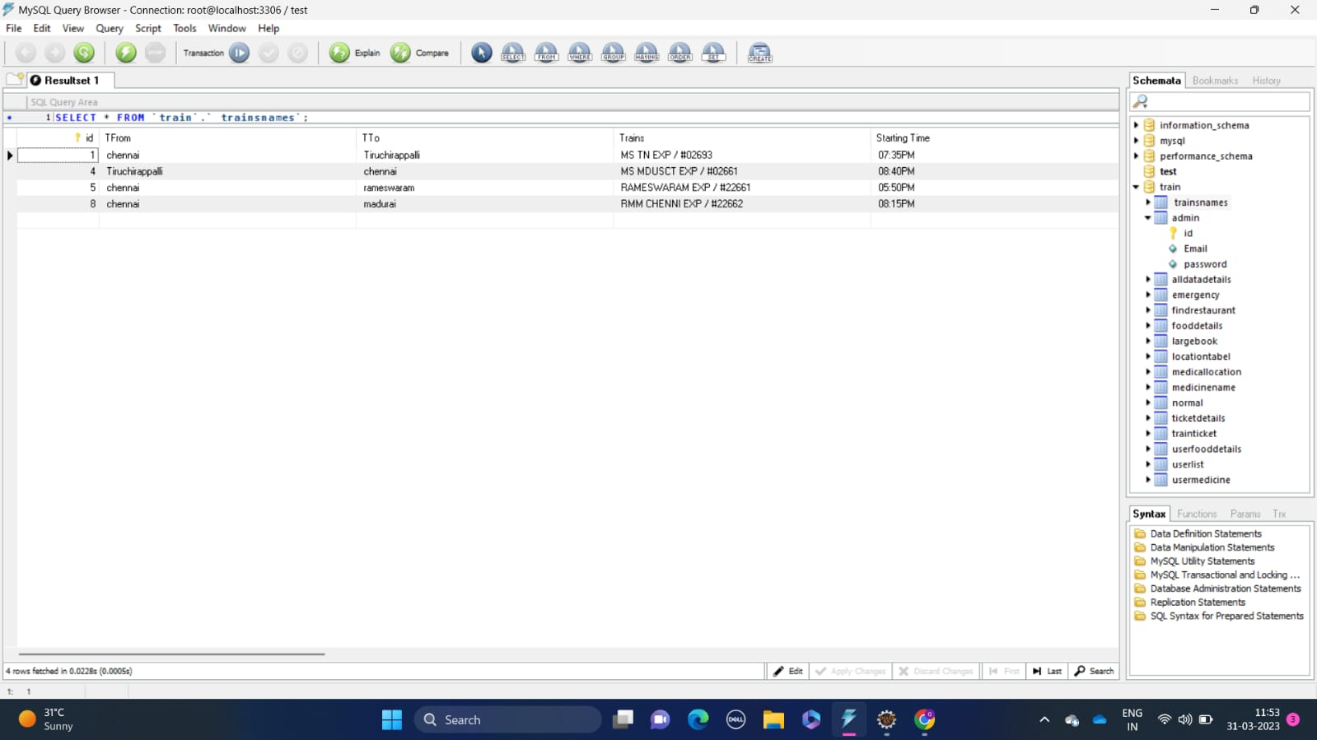
SCREENSHOTS
1. Train Detection
2. Train Database

Slide 38

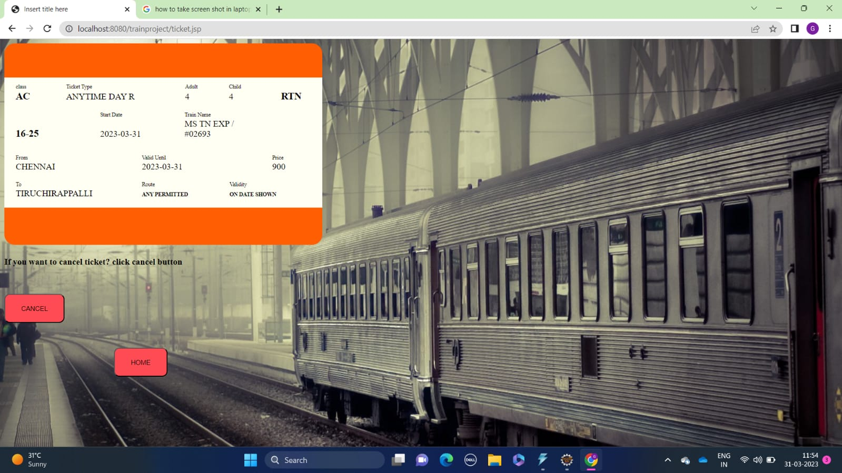
3. Admin Page
4. User Booking Train Ticket

Slide 39
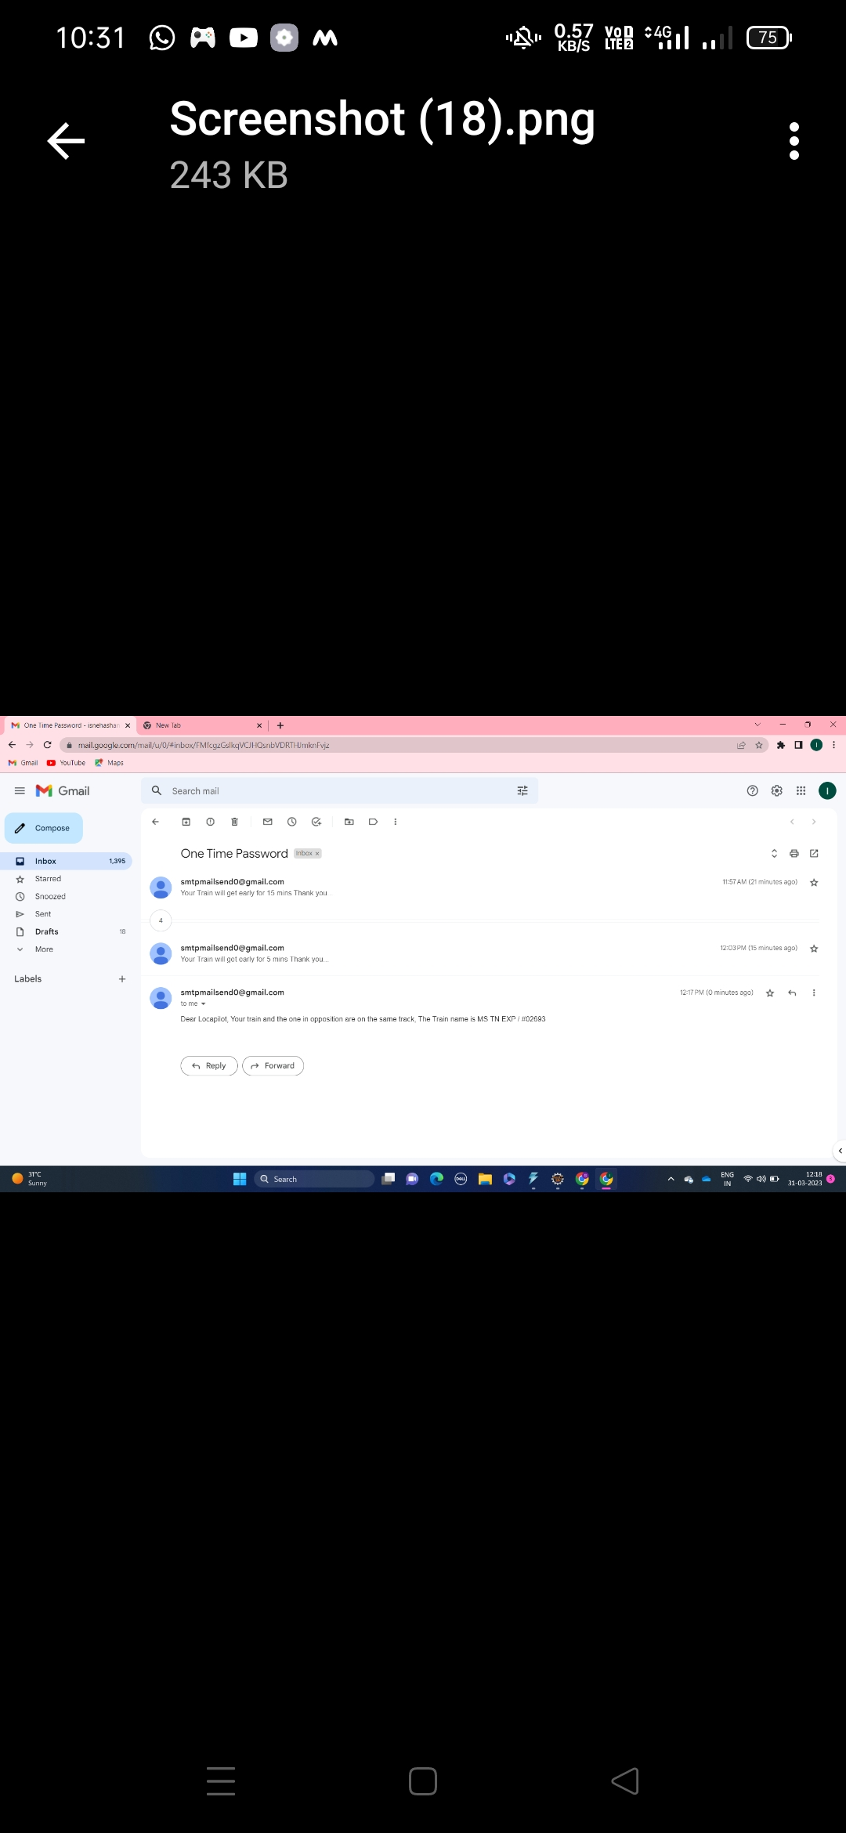
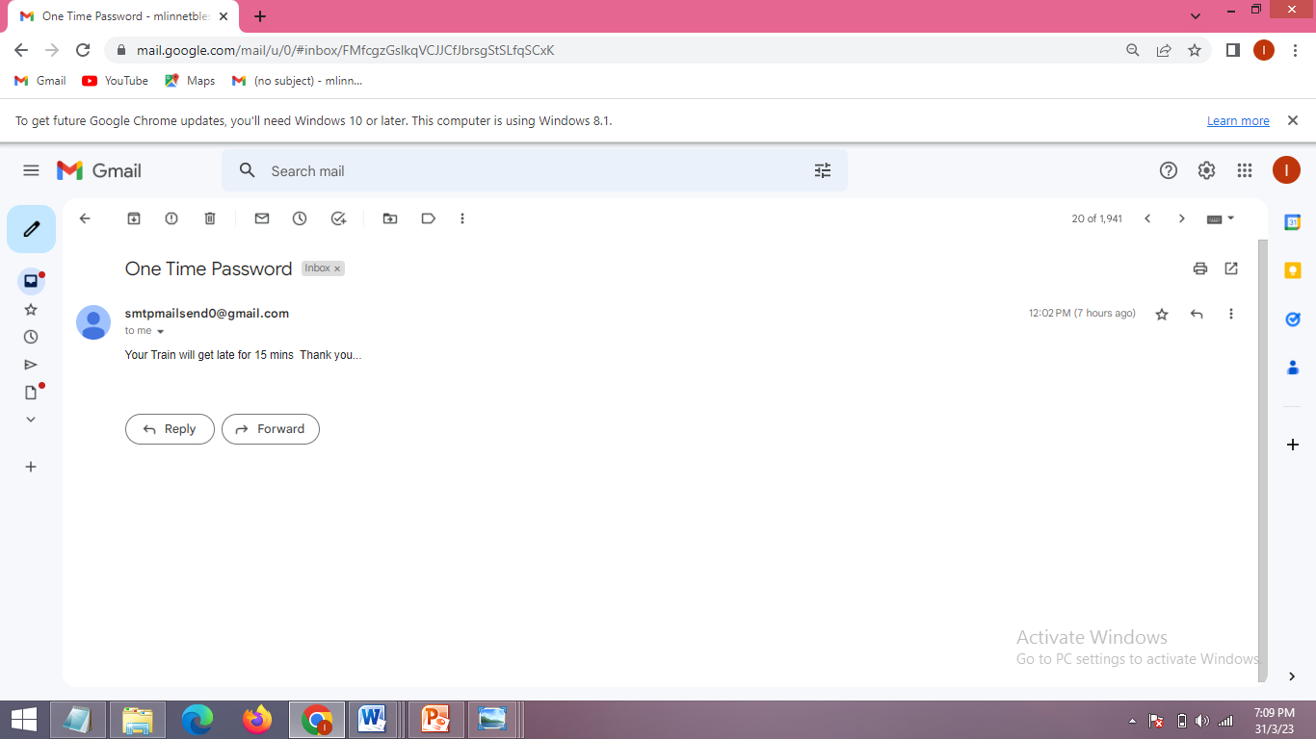
5. Message For Early Arrival Of Train
6. Message For Delay Arrival Of Train

Slide 40
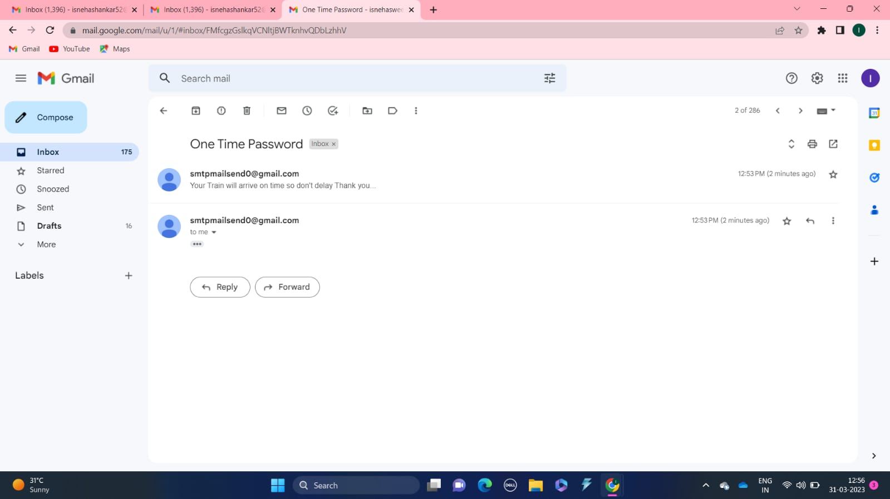
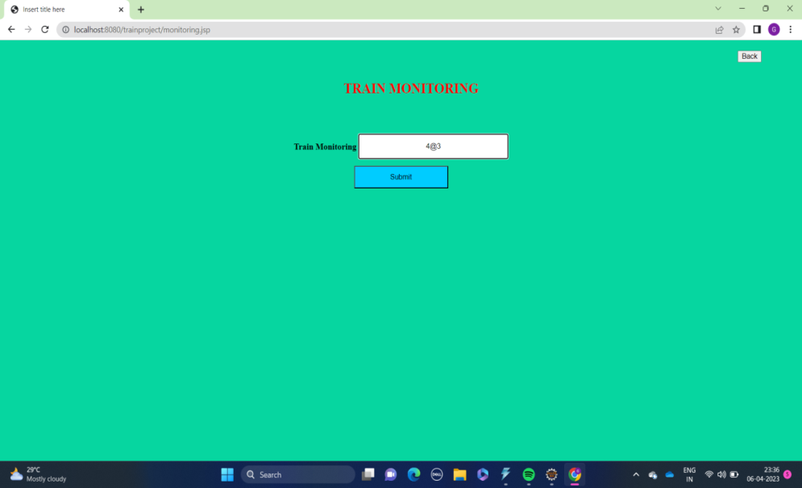
7. Message For On-time Arrival Of Train
8. Updating Train Information To Web App
9. Message For Track Allocation To The Loco Pilot

Slide 41
CONCLUSION
Rail transportation is acknowledged as an energy-efficient (though capital-intensive) and environmentally friendly mode of transportation. This project focuses on improving train schedules on railway networks. We attain our goal with the aid of an embedded system. The sensor approach is used to create this paradigm. This device detects the arrival time of the train using sensors ,RTC , RFID reader ,Tag. Railways may be made more appealing to travellers by lowering waiting times, accidents, and increasing the number of services and timeliness i.e punctuality. It is helpful to intimate to the passengers whether the train arrives to the station on time , if another train arrives in same track it will intimate Loco Pilot through mail. And also helps to update the information with respected id’s. In future we can add alert if the train is delay. And also we can make the whole system is controlled by AI.

Slide 42
REFERENCE
Hafeez Ur Rehman Siddiqui, Adil Ali Saleem, Muhammad Amjad Raza, Kainat Zafar,Kashif Munir,Sandra Dudley,” Iot Based Railway Track Faults Detection And Localization Using Acoustic Analysis”,2022
Alan Shaju,Aravind Madhu ,Doel Sam,“Automated railway track crack detection system”2022
Yanqiu Li,Xinyue Xu, Jianmin Li,Rui Shi,“A Delay Prediction Model For High-Speed Railway”2020
Hamad Alawad, Sakdirat Kaewunruen, Min An, “A Deep Learning Approach Towards RailwayAssessment”2020
Qi Zhang, Zhiming Yuan, Lu Yan, Tao Zhang, Yifeng Miao, Shuxin Ding"A Railway Train Number Tracking Method Using A Prediction Approach",2019

Slide 43
Y. Baviskar, U. Suryawanshi, A. Sheikh ,” Modelling of Track Layout for Intelligent Railway Signalling System: A Machine Learning Application”2018
DR.R.Velayutham,T.Sangeetharani,K.Sundaralakshmi”Controlling Railway gates using smart phones by tracking trains with GPS”2017
Dr. F. Balouchi,Dr. A. Bevan,R. Formston,"Detecting Railway Under-track Voids Using Multitrain In-service Vehicle Accelerometer",2017
Sarngadi Palgunadi,Dian Supraba , Bambang Harijito"Job-shop Scheduling Model For Optimization Of The Double Track Railway Scheduling"2016
J.Guo,X.Wang,Y.Zhang,Y.Yang,” Future prospects on the intelligent monitoring technologies for Railway Signalling system”2014

Slide 44


